Slide 1

Strategy Management

Slide 2




ur agenda
Introduction
What is Strategy ?
What is Strategy management ?
Process of creating strategy
Conclusions
References

Slide 3
Introduction
There is a need in modern times for strategies to achieve agreed goals and objectives, giving a sense of purpose and direction to the organization, because of recent technological and social changes and competition from rival organizations.
In ancient Greek, ‘stratos’ was the term for the army and so in military terms, ‘strategy’ referred to ‘the act of the general’ so a strategy is some sort of future plan of action, undertaken by senior management at a high level of abstraction.
A strategy is the mediating force or ‘match’ between the organization and the environment ‘according to Hofer and Schendel (1979).

Slide 4
What is strategy ?
A strategy reflects the personality of an organization and defines its business intent over a period of time.
Strategic management is the ongoing planning, monitoring, analysis and assessment of all necessities an organization needs to meet its goals and objectives.
Changes in business environments will require organizations to constantly assess their strategies for success.
The strategic management process helps organizations take stock of their present situation, chalk out strategies, deploy them and analyze the effectiveness of the implemented management strategies.

Slide 5
Strategy
Key Goals
Themes
Objectives
Key Results

Slide 6


OKRs
Definition
OKR (Objectives and Key Results) is a goal setting system used by companies. It is a simple approach to create alignment and engagement around measurable and ambitious goals.
Doerr’s formula is the best way to explain the structure of an OKR:
I will (Objective) as measured by (this set of Key Results).
OKR has two components, the Objective and the Key Results:
Objectives:
What we want to achieve
Key Results:
How are we going to measure our progress?
Objectives are
memorable qualitative descriptions of what you want to achieve.
Objectives should be short, inspirational and engaging.
An Objective should motivate and challenge the team
Key Results are
a set of metrics that measure your progress towards the Objective.
For each Objective, you should have a set of 2 to 5 Key Results.
More than that and no one will remember them

Slide 7
OKRs
Generally OKR is 4 in one year which are below.
1st January to 31th March
1st April to 30th June
1st July to 30th September
1st October to 31st December

Slide 8
SWOT Analysis
S W O T
Strengths
Weaknesses
Opportunities
Threats
Internal
External
The central purpose of the SWOT analysis is to identify strategies that align, fit or match an organization's resources and capabilities to the demands of the environment in which the organization competes.
Some key points on SWOT
Too much detail should be avoided. Keep each variable short.
Many variables may be relative rather than absolute and therefore will require some judgement.
Do not ignore ‘soft’ facts (e.g. organizational culture, leadership skills, etc).
Prioritize and combine variables.
Be realistic in its assessment.
SWOT is not strategy. It only provides a platform for planning for the future.

Slide 9
SWOT Analysis
Strengths
Weaknesses
Core competencies in key areas.
Adequate financial resources.
Well-thought-of by buyers.
An acknowledged market leader.
Well-conceived functional area strategies.
Access to economies of scale.
Insulated (at least somewhat) from strong competitive pressures.
Proprietary technology.
Cost advantages.
Better advertising campaigns.
Product innovation skills.
Proven management.
Ahead on experience curve.
Better manufacturing capability.
Superior technological skills.
No clear strategic direction.
Obsolete facilities.
Profitability issues because…
Lack of management depth and talent.
Missing some key skills or competencies.
Poor track record in implementing problems.
Falling behind in R&D.
Too narrow product line.
Weak market image
Weak distribution network.
Below-average marketing skills.
Unable to finance needed changes in strategy.
Higher overall unit costs relative to key competitors

Slide 10
SWOT Analysis
Opportunities
Threats
Ability to serve additional customer groups or expand into new markets or segments.
Ways to expand product line to meet broader range of customer needs.
Ability to transfer skills or technological know-how to new products or businesses.
Integrating forward or backward.
Falling trade barriers in attractive foreign markets.
Complacency among rival firms.
Ability to grow rapidly because of strong increases in market demand.
Emerging new technologies.
Entry of lower-cost foreign competitors.
Rising sales of substitute products.
Slower market growth.
Adverse shifts in foreign exchange rates and trade policies of foreign governments.
Costly regulatory requirements.
Vulnerability to recession and business cycle.
Growing bargaining power of customers or suppliers.
Changing buyer needs and tastes.
Adverse demographic changes.

Slide 11
Process of creating strategy in Uppwise
Filling in the Strategy Form. Start working with your strategy by defining and describing it.
Defining a Strategic Theme. Once you have described your strategy, the next step is to integrate your themes as the strategy's defining pillars.
Defining a Key Goal. Next, you have the tools at hand for defining your theme's vertical objectives as well as the key goals that connect them together horizontally.
Defining a Strategic Budget. As a final step in the initial creation process, you create a strategic budget, which is made up of value streams defining end to end services or products provided to the business in order to realize benefits, such as revenue.

Slide 12

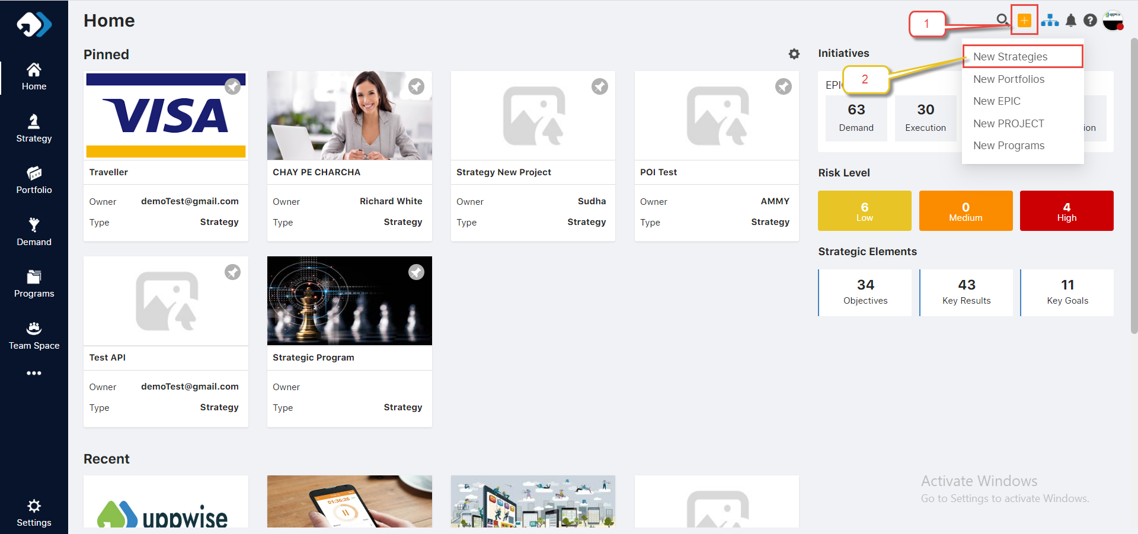
1. Filling in the Strategy Form
1. Open Strategy form landing page by click plus icon → New Strategy

Slide 13
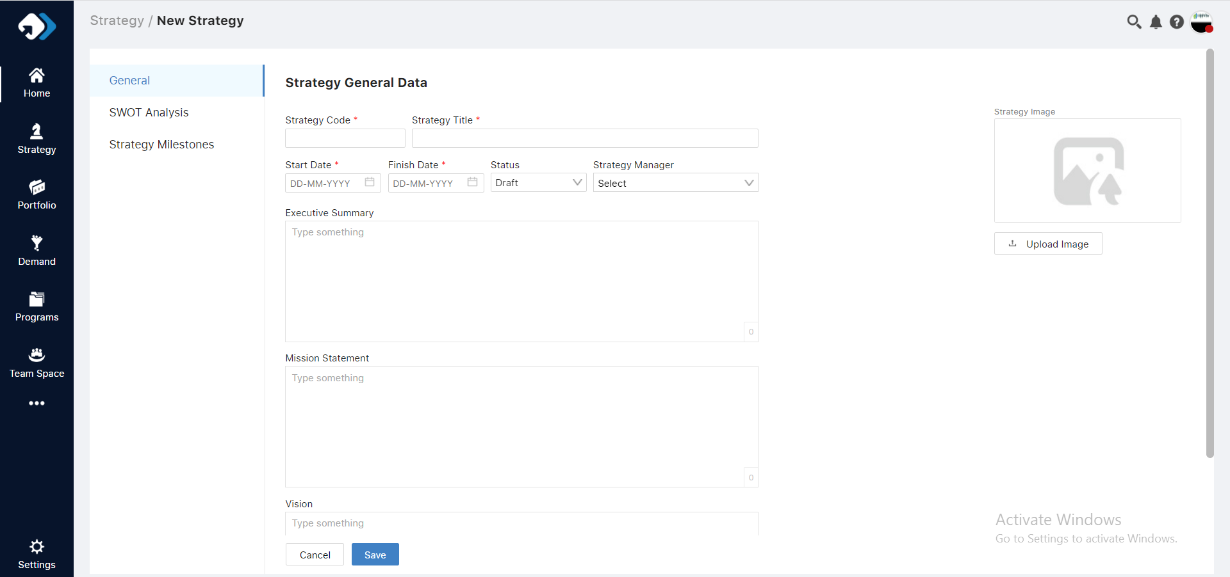

2. Fill the all fields according to requirement
The Strategy Code is generated by Uppwise, you can change it, though note that after you save the general strategy data, you will not be able to change the strategy code anymore.
The Status of a strategy determines the functionality that Uppwise makes available for your strategy.
Notes

Slide 14
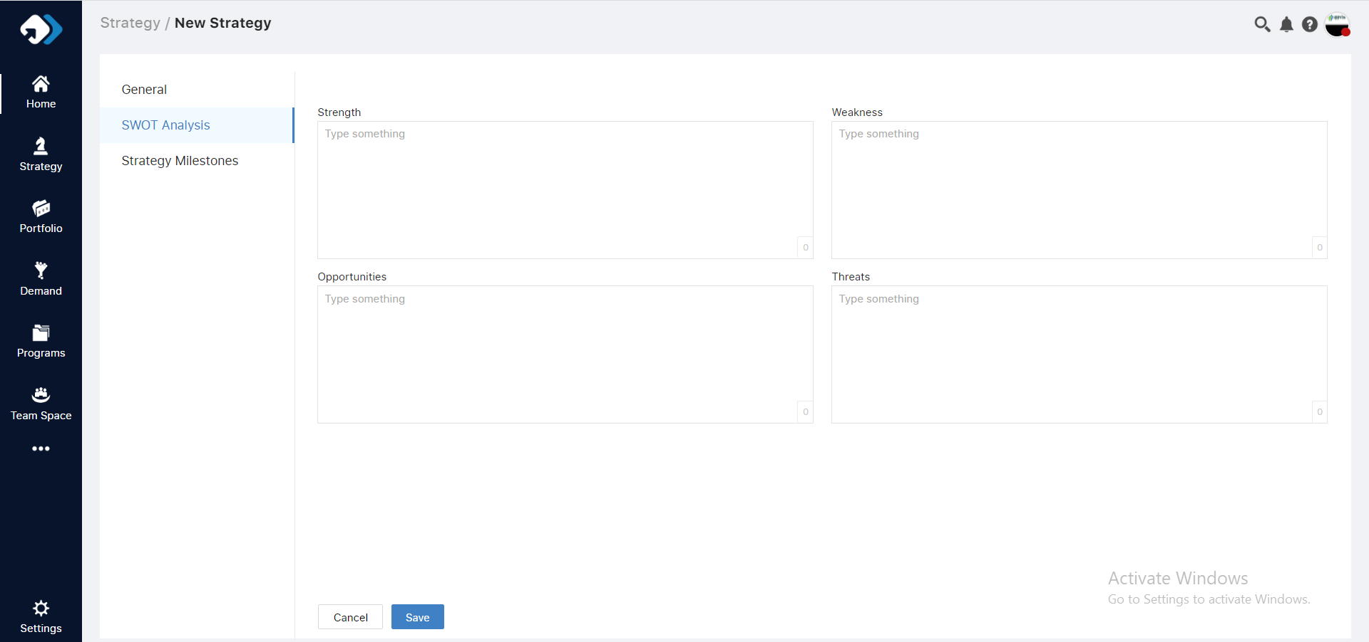
3. Define SWOT Analysis

Slide 15
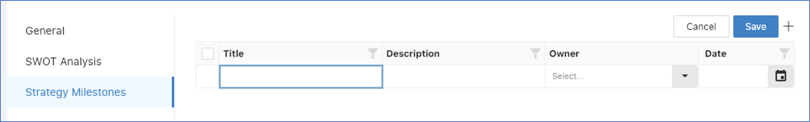
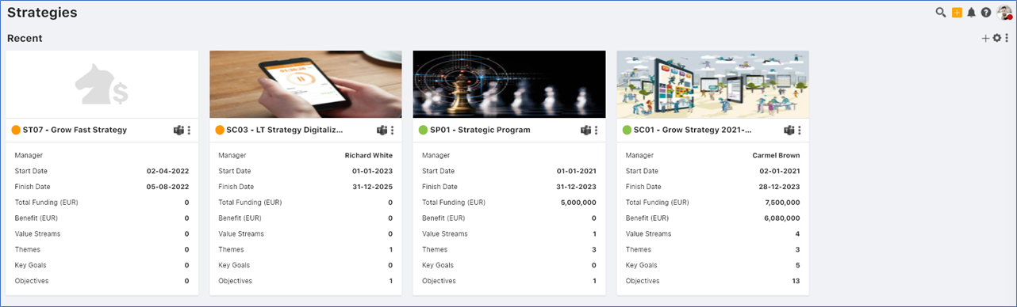
4. Define Milestones Analysis
5. Click Save to save the new strategy.
It is now displayed on the Strategy Landing Page, as shown below.
Notes
Status
Draft
Active
Close

Slide 16

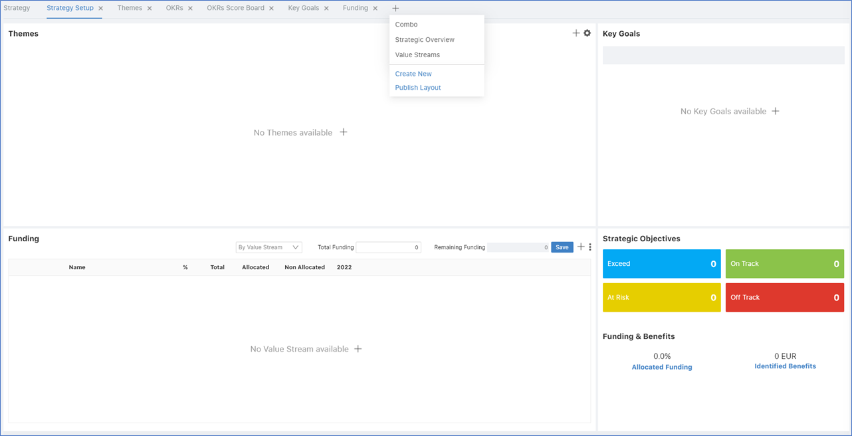
2. Defining a Strategic Themes
In the main navigation bar, click Strategic Setup, as shown below.
When no strategy has been defined, the Strategic Themes Dashboard opens and looks as shown below.

Slide 17
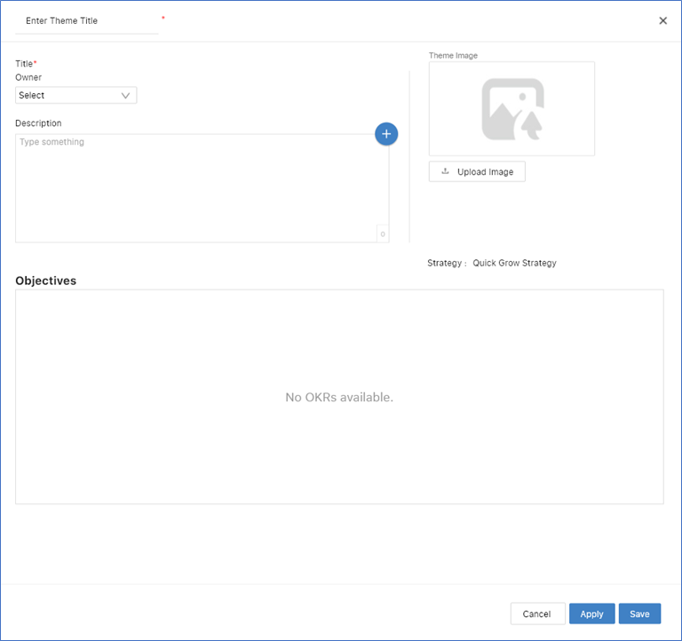
Click the + icon in the top right of the Themes area, or within the Themes area itself, and the Strategic Theme Form opens, as shown below.

Slide 18
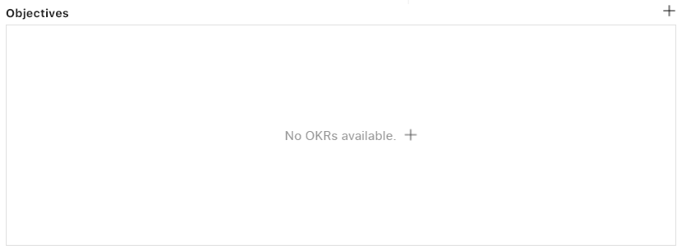
When you click Save, the form closes.
When you click Apply instead, a save is done and the Strategic Theme Form will still be open, letting you click through to creating new objectives, without exiting the form and needing to open the Objective Form separately.

Slide 19
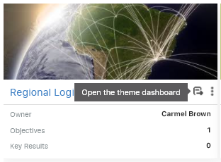
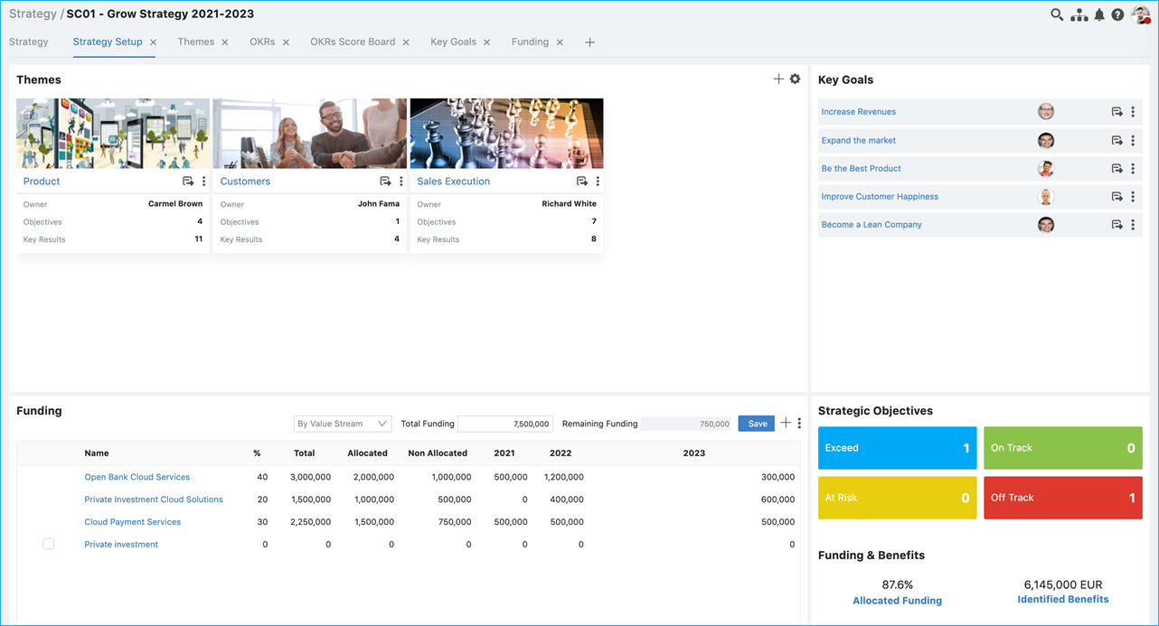
Click the Open icon in the card that has been created for you in the Strategic Themes Dashboard and, when the Themes Dashboard opens, the selected theme's information will be displayed in the dashboard.
When the Strategy Setup Dashboard is populated by your themes, it will look comparable to the below.

Slide 20
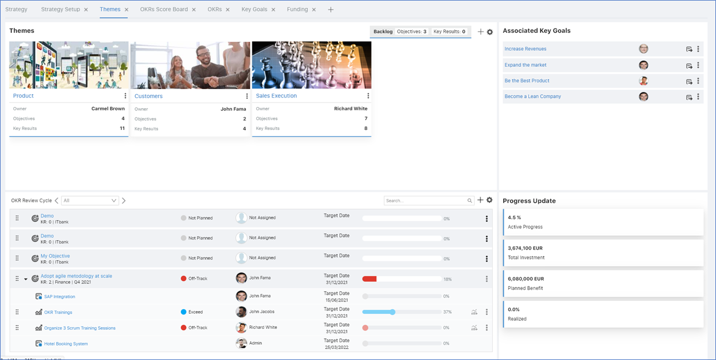
Notes
The Themes Dashboard populated with content looks as follows, once its OKR Review Cycle has been activated

Slide 21
3. Defining a Key Goal
In Uppwise, you have the tools at hand for defining your theme's vertical objectives as well as the key goals that connect them together horizontally.
A key goal is a step in a strategy that connects elements across a strategy.
While themes are vertical pillars, key goals are horizontal elements that connect across a strategy.
Follow the all steps of defining strategy themes
For quick scheduling, while your strategy is in draft, you can use the handlebars to drag and drop an objective onto an Associated Theme in the top right of the Key Goals Dashboard, shown above.
Notes

Slide 22

4. Defining a Strategic budget
In Uppwise, a strategic budget is made up of value streams defining end to end services or products provided to the business in order to realize benefits, such as revenue.
Overview
When you have defined your strategic themes, you create a strategic budget as described below, by:
entering the total funding amount to serve as the basis for your value streams
mapping your investment over the reference period to your value streams and portfolios
Each value stream has its own value proposition and the total benefit associated with it through the calculation of all the initiatives reflected in the value stream.

Slide 23
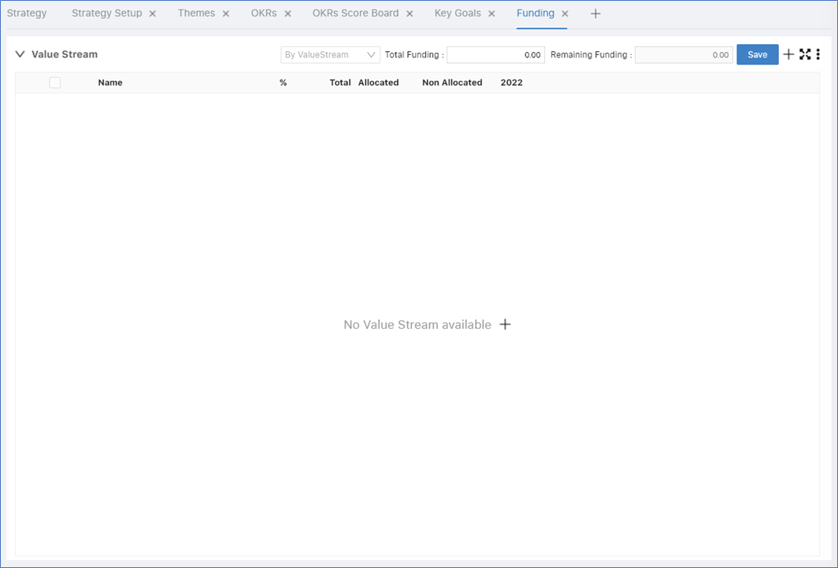
Follow the steps below to define a strategic budget by creating value streams and assigning value streams to portfolios.
Getting Started
1. In the main navigation bar, click Funding, as shown below. When no funding has been defined, the Funding Dashboard opens and looks as shown below.

Slide 24
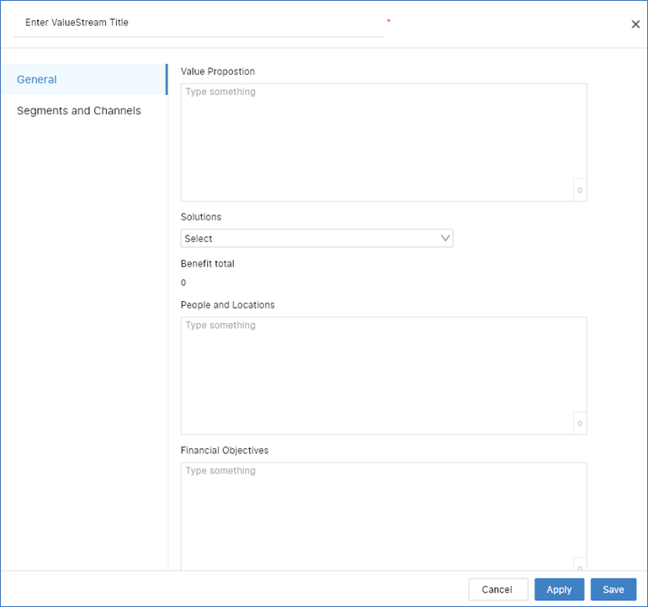
2. Click the plus icon to begin creating a new value stream. The Value Stream Form opens, as shown below.

Slide 25
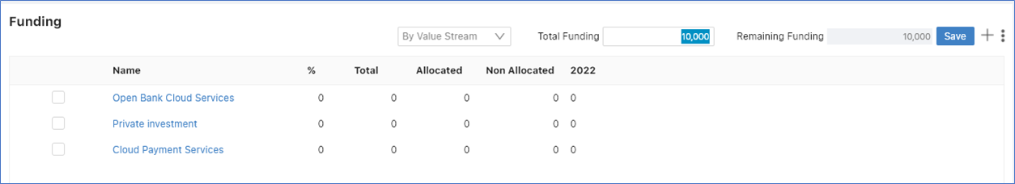
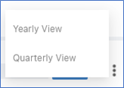
Allocate Funding to Value Streams
Once you have created more than one value stream, enter your total funding, which is set to 10,000 below, click Save, and you will be ready to divide the allocated funding over your value streams.
Click the 3dot icon in the top right to specify whether the yearly or quarterly view should be shown.

Slide 26
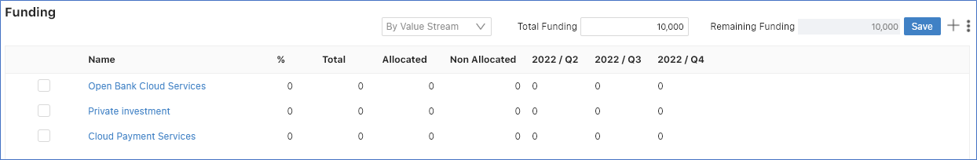
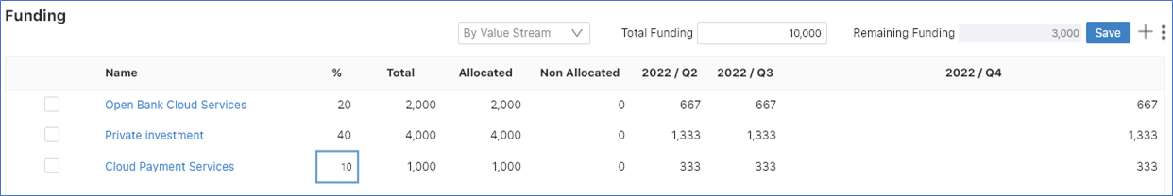
When displayed as Quarterly View, the Funding area is displayed as follows:
Use the percentage column to allocate the percentage of the total funding to each value stream.
Uppwise will calculate the applicable amounts for you based on the duration of the strategy, as shown below.
You can then further fine-tune the allocation by adapting the allocated funding per time period. For example, in the 2022/Q2 and 2022/Q3 columns below, change the allocated budget as needed.
Alternatively, enter the amounts directly, in the Allocated column, and Uppwise will calculate and update the percentage column for you.

Slide 27
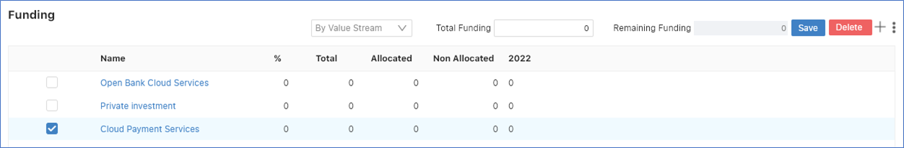
When you want to delete a funding, you can only delete one funding at a time, that is, the Delete button will only be available when one funding has been selected.
Notes

Slide 28
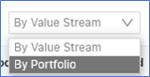
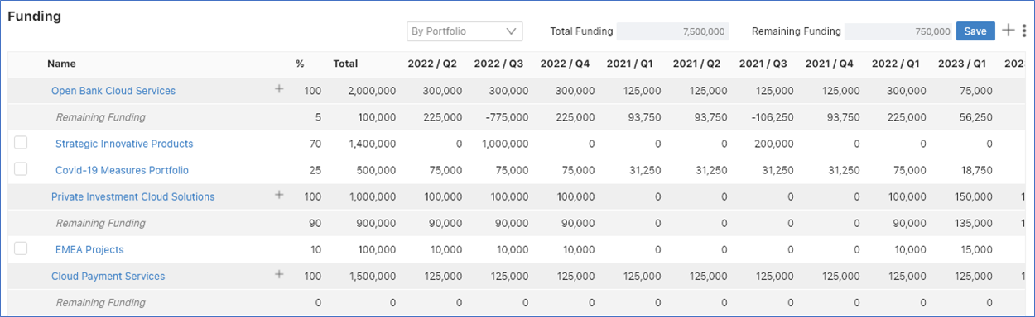
Allocate Value Streams to Portfolios
Previous slides the Funding area, click the By Value Streams drop-down list and select By Portfolio, as shown below.
The By Portfolio filter shows you the portfolios to which the value streams have been assigned within your strategy.

Slide 29
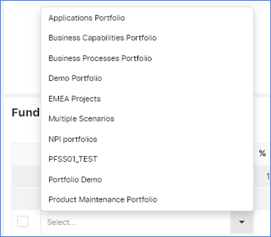
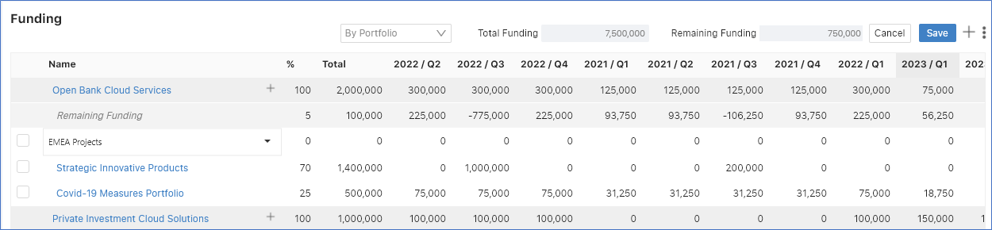
Click the plus button next to a value stream to select and add a new portfolio, as shown left.
Once you have added a new portfolio, you can allocate funds to it from the value stream, using the percentage column or the column for a specific timeslot within your reference period, as discussed above.

Slide 30
Managing Objectives and Key Results
Setting Up an OKR Review Cycle. Quickly and easily set up and use tools at your disposal in support of the Objectives & Key Results (OKRs) methodology for the management of your objectives to effectively realize your strategy.
Defining an Objective. Set up your objectives as targets that need to be achieved through a number of key results to fulfil the scope of the strategy.
Defining a Key Result. Once objectives have been defined, you set up the related key results as measurable achievements to contribute to the realization of the objective.

Slide 31
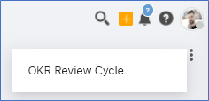
1. Setting up an OKR Review Cycle
In Uppwise , you are supported by tools to let you set up and use the Objectives & Key Results (OKRs) methodology for the management of your objectives to effectively realize your strategy.
Steps
1
In the top right of the Strategy landing page, click the vertical ellipsis and click OKR Review Cycle, as shown below.
The OKR Review Cycles are shown. Here you can view the available cycles.

Slide 32
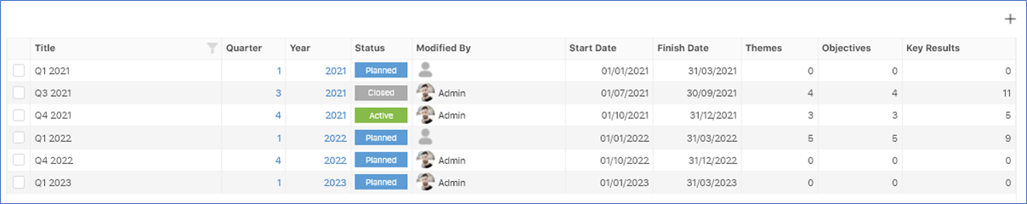
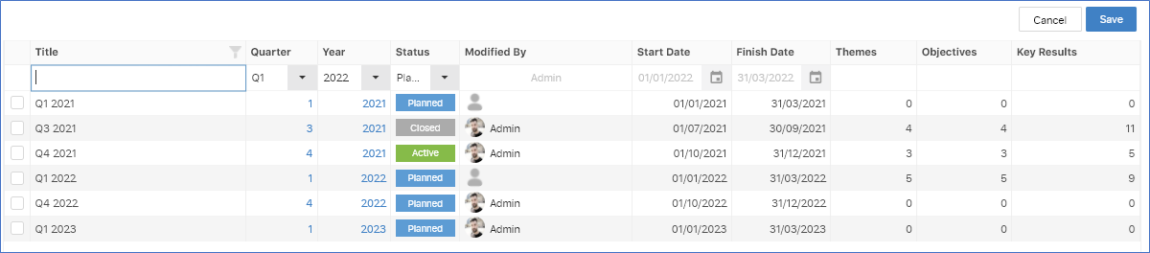
2
Click the + icon in the top right to create a new cycle.
3
A new row is added at the top of the list where you can add a new cycle.
4
One OKR Review Cycle can be set to be active at the same time. See Activating an OKR Review Cycle for details.

Slide 33
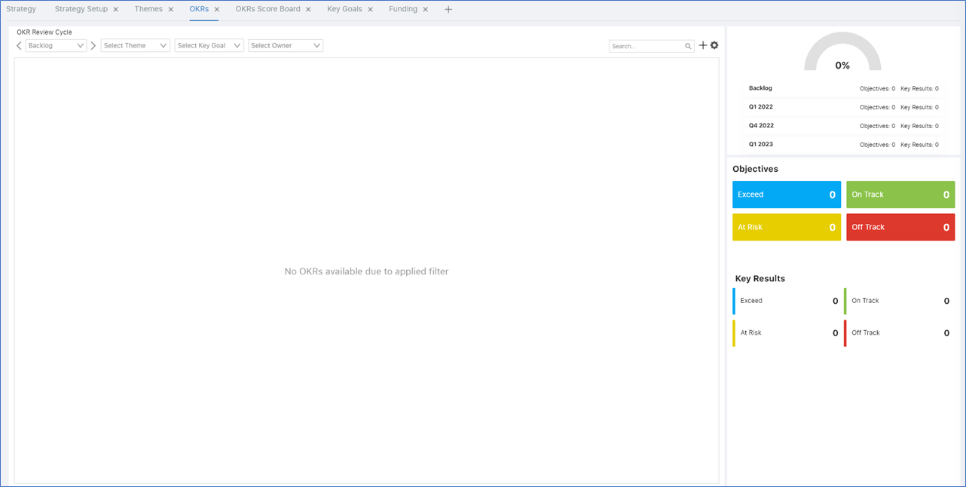
2. Defining an Objective
In Uppwise, you have all the tools you need to set up your objectives as targets that need to be achieved through a number of key results to fulfil the scope of the strategy.
An objective can be assigned to a strategic theme, a key goal, or both.
Steps
1
In the main navigation bar, click OKRs, as shown below.
When no OKRs have been defined, the OKR Dashboard opens and looks as shown below.

Slide 34
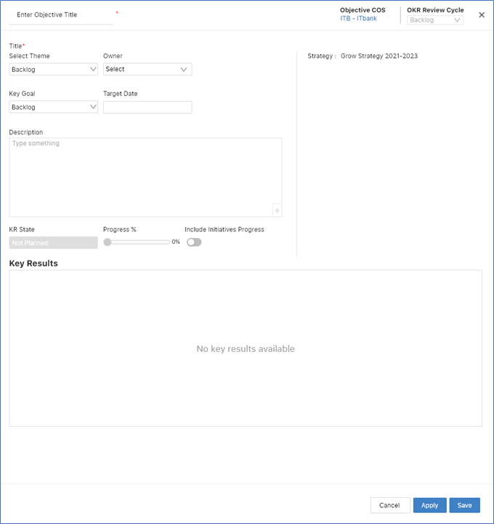
2
Click the plus icon in the top right of the OKR Dashboard.
The Objective Form opens, as shown below.
The OKR Review Cycle drop-down list lets you set the reference period within which the objective is to be achieved. When the OKR Review Cycle that you set for your objective is activated, you will be able to track progress of the objective and its key results. See Activating an OKR Review Cycle and Tracking Progress of Objectives and Key Results for details.
The Include Initiatives Progress switch determines whether the progress of the projects attached to your strategy and its objectives will be tracked, as shown in Tracking Progress of Objectives and Key Results.
The Theme drop-down list lets you assign an objective to one theme.
The Key Goal drop-down list lets you assign an objective to one key goal.
Notes
If your objective belongs to more than one theme or key goal, it needs to be split into more than objective.
Fill in the details following your business requirements.

Slide 35
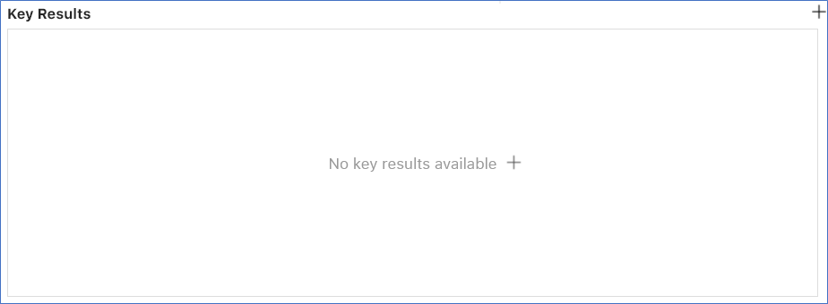
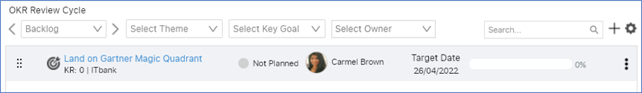
3
When you click Apply, the Objective Form stays open and you can define the related key results, using the lower area in the Objective Form, as shown below.
4
When you click Save, the objective is listed in the OKR Dashboard, as shown below.

Slide 36
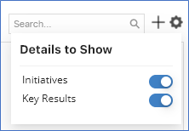
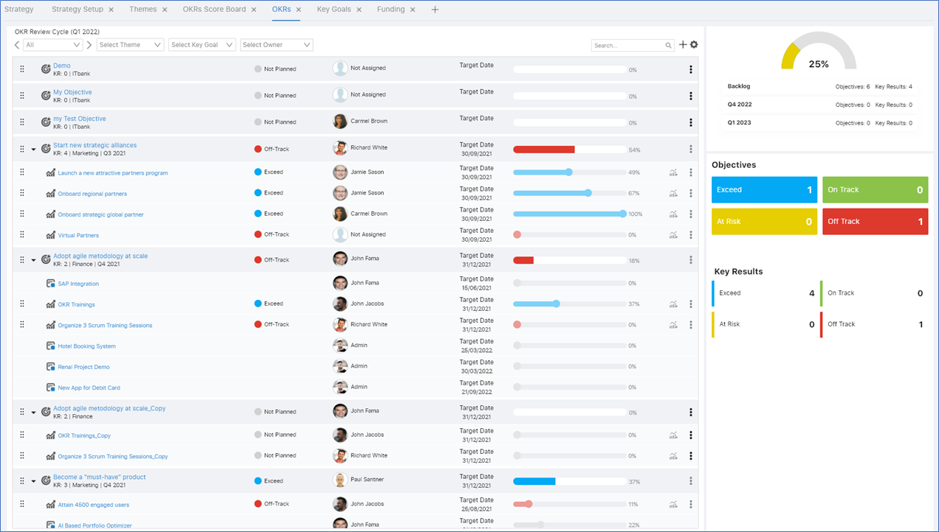
5
Click the gear icon in the top right of the OKR Dashboard to set the items to be displayed in the OKR Dashboard.
6
When the OKR Dashboard is populated by your objectives and its OKR Review Cycle has been activated, it will look comparable to the below, enabling you to update and monitor its progress.
Notes
For quick scheduling, you can use the handlebars to the left of an objective to drag and drop an objective onto an OKR Review Cycle in the top right of the OKRs Dashboard, shown left.

Slide 37
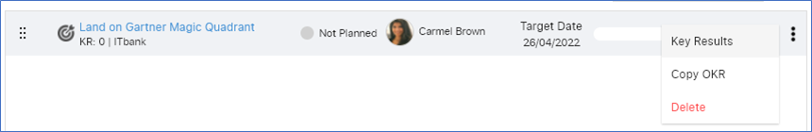
3. Defining an Key Results
In Uppwise, once objectives have been defined, you set up the related key results as measurable achievements to contribute to the realization of the objective.
Steps
1
In the OKRs Dashboard, once you have defined an objective, click its vertical ellipsis button, as shown below, to begin creating a new key result.

Slide 38
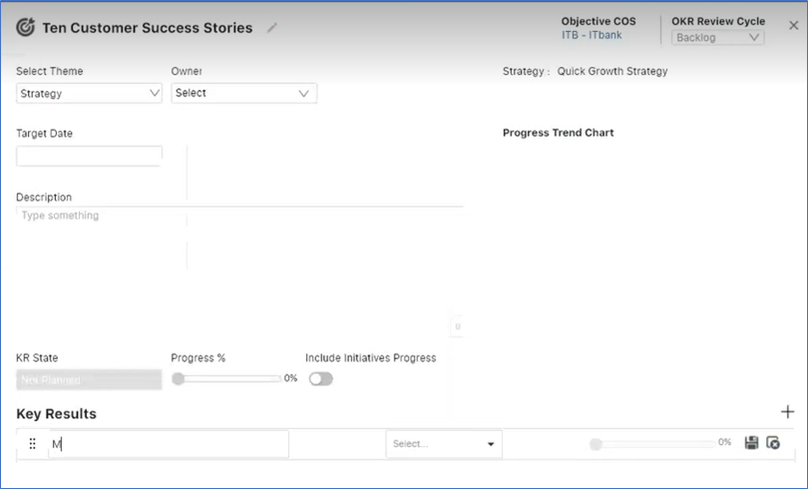
Alternatively, in the Objective Form, which you use when you define objectives, you can add the objective's key results, instead of using the dashboard:

Slide 39
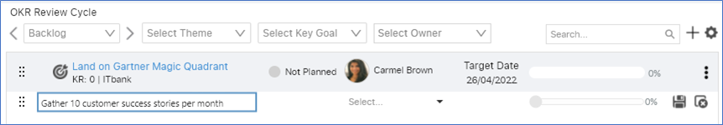
2
A new row is added in-line, below the objective, where you can fill in the details of the key result, as shown below.
3
Click the Save icon to confirm and store the definition of the new key result.

Slide 40
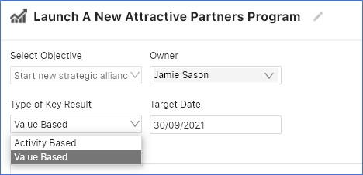
Activity Based and Value Based Key Results
1
Click the key result in the OKRs Dashboard or in the Objective Form.
The Key Result Form opens, where you can specify whether the selected key result is activity based or value based, as shown below.

Slide 41
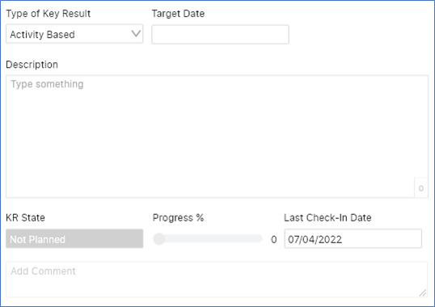
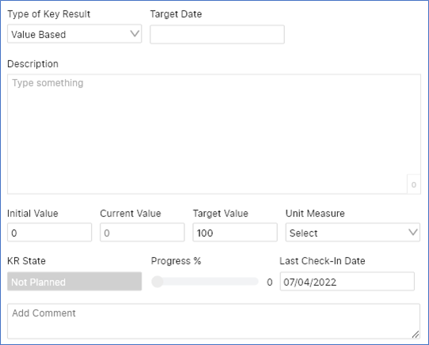
2
When the key result is value based, the information you will be able to add to track progress will be numeric, as shown below.
3
When the key result is activity based, the information you will be able to add to track progress will be percentage-based, as shown below

Slide 42
Tracking Strategic Performance
Tracking strategic performance in Uppwise consists of the following tasks.
Verifying the Value of a Value Stream. The association of strategies, portfolios, and projects unlocks the complete chain of information about strategies, portfolios, and projects to answer in one glance the investment spent and the value realized by the strategy's value streams and associated portfolios.
Activating an OKR Review Cycle. By activating an OKR Review Cycle, you determine the period within which objectives and key results are intended to be achieved and during which they can be tracked and monitored.
Tracking Progress of Objectives and Key Results. Once your strategy is open and the relevant OKR Review Cycle has been activated, you're ready to track and monitor the strategy's progress.

Slide 43
1. Verifying the Value of a Value Stream
In Uppwise, the association of strategies, portfolios, and projects unlocks the complete chain of information about strategies, portfolios, and projects to answer in one glance the investment spent, and the value realized by the strategy's value streams and associated portfolios.
As strategy manager, your fundamental question is how to assess and verify the value realized by your company’s value streams and their associated portfolios.
Steps
1
Define a strategic budget.
Already explained in previous slides

Slide 44
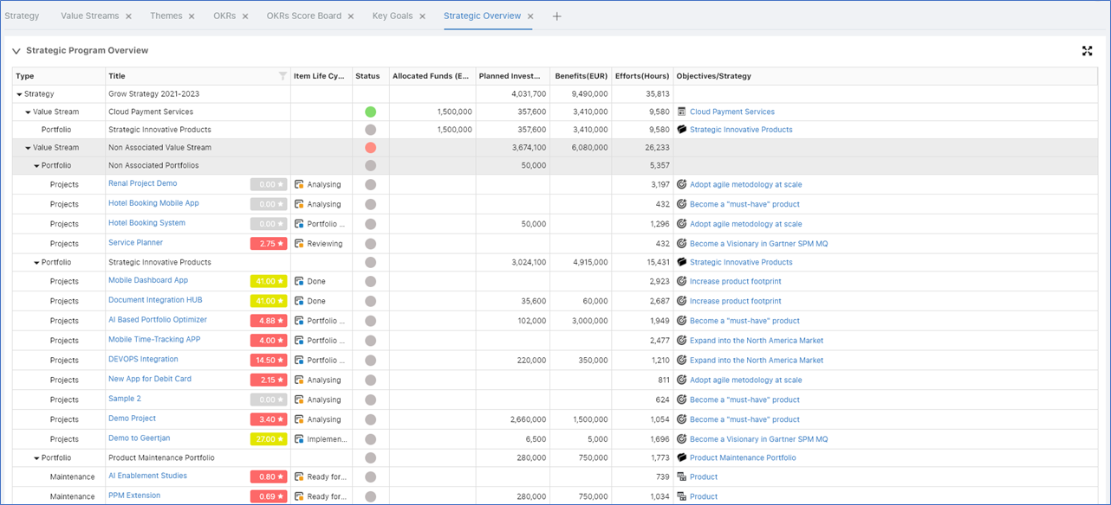
2
In the main navigation bar, click Strategic Overview, as shown below.
For each strategy, you can now see your value streams, the portfolios they fund, and the related projects that are financed by them.

Slide 45
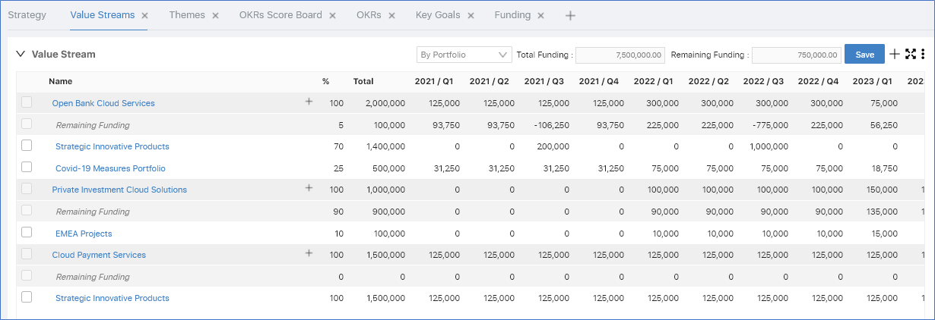
3
In the main navigation bar, click Value Streams, as shown below.
Instead of a full view covering your strategies, here you see all the value streams and their funding over the reference period.

Slide 46

2. Activating an OKR Review Cycle
In Uppwise, you can set up and enable tools to support the OKR methodology, which is the basis of OKR Review Cycles, determining the period within which objectives and key results are intended to be achieved and during which they can be tracked and monitored.
Follow the steps below to activate an OKR Review Cycle, against which you can then monitor the performance of your strategy.
1
In the top right of the Strategy Landing Page, click the vertical ellipsis and click OKR Review Cycle, as shown below.
The OKR Review Cycles are shown. Here you can view the available cycles.
See Setting Up an OKR Review Cycle for details on creating new cycles.

Slide 47
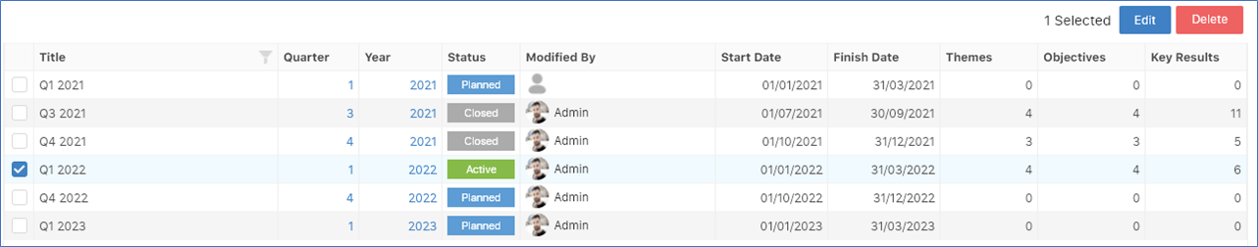
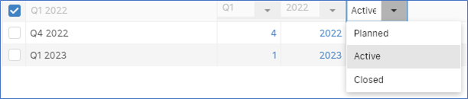
2
Only one OKR Review Cycle can be active at any one time.
To make a different cycle active, start by changing the status of the currently active cycle. Check the checkbox next to the active cycle, as shown below, and click Edit.
3
Now you can change the status of the active cycle, as shown below.

Slide 48
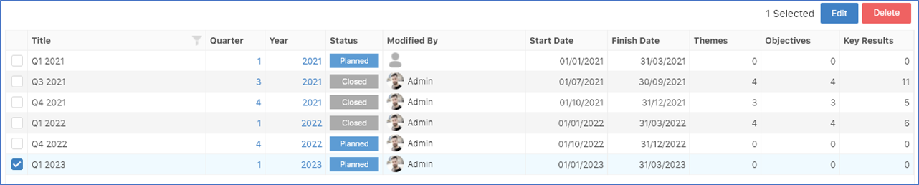
4
Click Update.
Uppwise shows you a warning message because changing the status of an OKR Review Cycle impacts the progress that can be reported against it:
If you update the status of a cycle from Active to Planned, progress is set to zero for the associated objectives and key results.
If you update the status of a cycle from Active to Closed, the objectives and key results will be closed and locked for further editing.
5
Now that no cycles are active, select a cycle, as shown below, and repeat the process above to make it active.

Slide 49
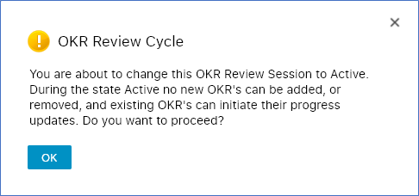
6
When you update an OKR Review Cycle to be active, you will see the message below, indicating that you will no longer be able to add objectives and key results to your strategy.

Slide 50
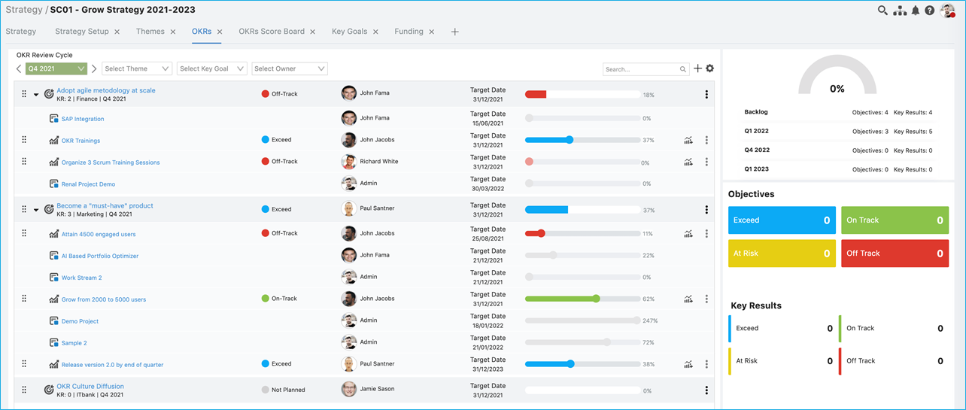
3. Tracking Progress of Objectives and Key Results
In Uppwise, once your strategy is open and the relevant OKR Review Cycle has been activated, you're ready to track and monitor the strategy's progress.
Follow the steps below to track the progress of your objectives and key results in Uppwise.
1
Activate an OKR Review Cycle, and make sure that the strategy status is set to open, to enable progress to be tracked for the specified reference period.
2
In the main navigation bar, click OKRs.
In the main navigation bar, click OKRs.
Use the OKR Review Cycle drop-down list in the top left to filter by a selected reference period.

Slide 51

3
Similarly, the OKR Review Cycles are also shown, and can also be filtered, in the lower part of the Themes Dashboard, as shown below.
Instead of showing all the objectives, the Themes Dashboard filters the display based on the currently selected themes.
In the screenshot above, two themes have been selected, the first and third, indicated by the blue line below the cards.

Slide 52
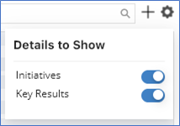
4
Click the gear icon in the top right of the OKR Review Cycle area to select whether the related initiatives (projects) or key results, or both, are shown.

Slide 53
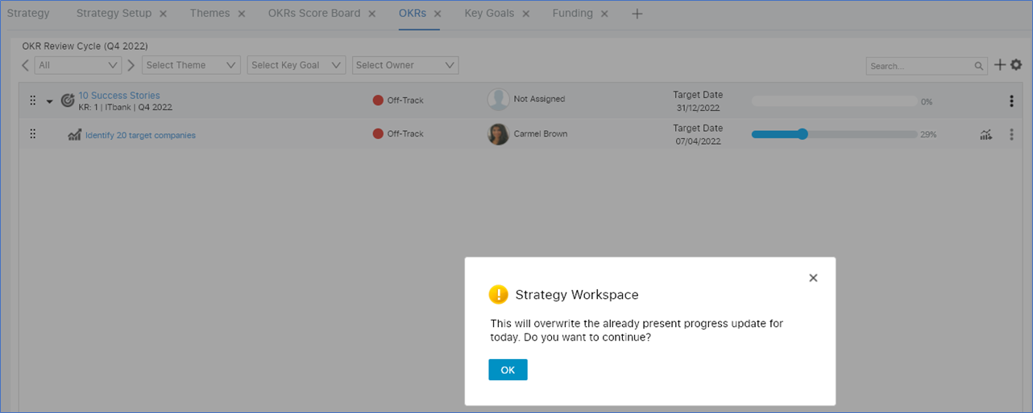
Tracking Progress
1
Move the progress bar left and right for a key result in the OKRs Dashboard to set the current progress and click OK to confirm, as shown below.
Uppwise automatically updates the progress of the objective based on updates to the progress of the key results that you provide.

Slide 54
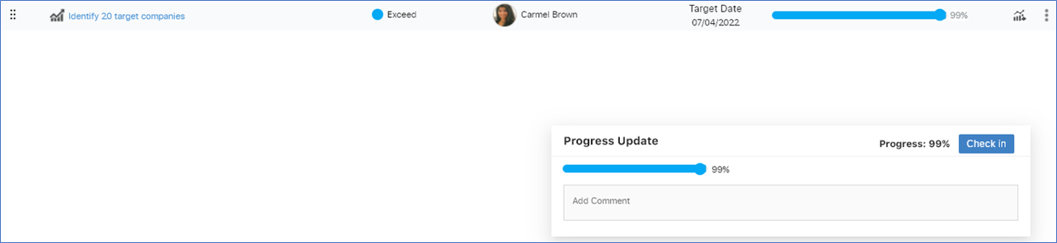
2
Alternatively, click the Update Progress button to the right of the key result in the OKRs Dashboard to pop up the Progress Update dialog, where you can update and check in the progress update, as shown below.
Notes
A comment can be added here, which will be stored with your progress update.

Slide 55
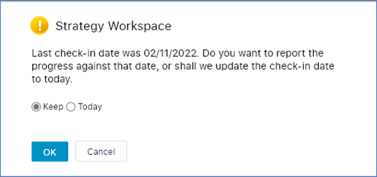
3
When there is a discrepancy between the last and current check-in dates, Uppwise helps you to select the correct date for the current progress update, as shown below

Slide 56
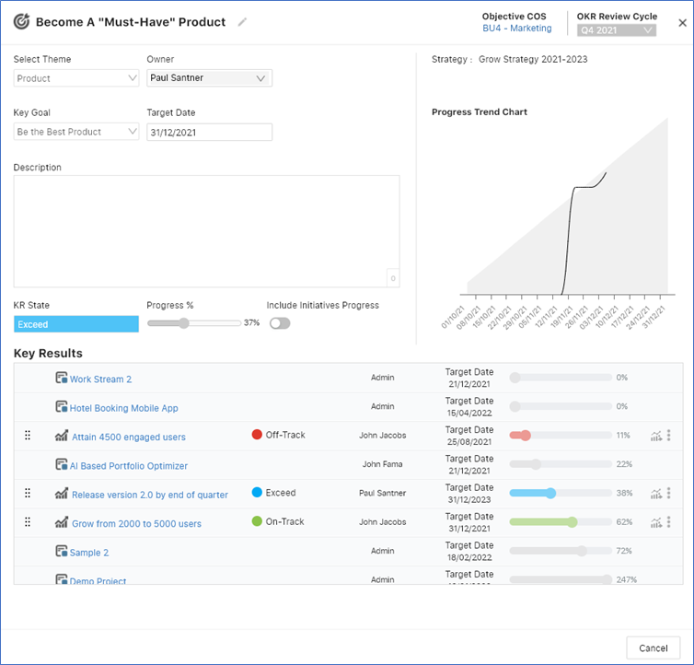
4
For each objective, you can track progress of the related key results, which are rolled up as shown below, when you click an objective in the OKRs Dashboard"

Slide 57
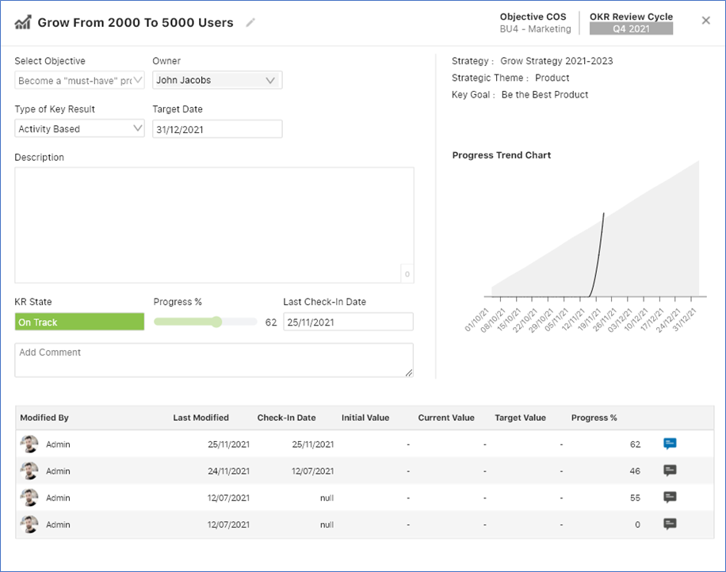
5
For each key result, you can see information about the updates that have been made, such as by who, and when, together with their comments, as shown below.

Slide 58
Conclusion
The study of strategic management provides tools to effectively manage organizations, but it also involves the art of knowing how and when to apply creative thinking.
Knowledge of both the art and the science of strategic management is needed to help guide organizations as their strategies emerge and evolve over time.

Slide 59
Thank You

